Slide 1
Abraham: Growing into greatness
Chapter 22

Slide 2
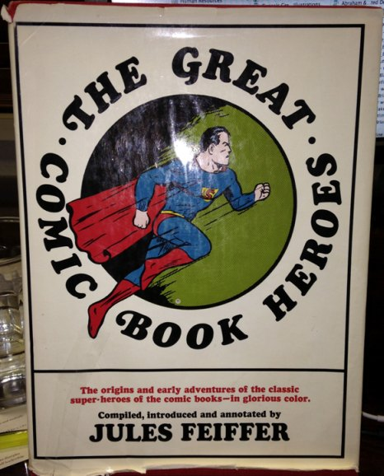

Slide 3
Abraham: Growing into greatness
Chapter 22

Slide 4
Growing into greatness requires testing
testing shows our faith
1 Peter 1:6–7
This brings you great joy, although you may have to suffer for a short time in various trials. Such trials show the proven character of your faith....

Slide 5
Growing into greatness requires testing
testing shows our faith
testing grows our faith
James 1:2–4
Consider it all joy, my brethren, when you encounter various trials, knowing that the testing of your faith produces endurance. And let endurance have its perfect result, so that you may be perfect and complete, lacking in nothing.

Slide 6
Growing into greatness requires testing
Exodus 13:2
“Sanctify to Me every firstborn, the first offspring of every womb among the sons of Israel, both of man and beast; it belongs to Me.”

Slide 7
Growing into greatness demands obedience
His obedience was immediate
His obedience was unwavering
His obedience was in hope

Slide 8
Growing into greatness demands obedience
Hebrews 11:17–19
By faith Abraham, when he was tested, offered up Isaac. He had received the promises, yet he was ready to offer up his only son. God had told him, “Through Isaac descendants will carry on your name,” and he reasoned that God could even raise him from the dead....

Slide 9
Growing into greatness demands obedience
His obedience was immediate
His obedience was unwavering
His obedience was in hope
His obedience was complete

Slide 10
great obedience receives perfect provision
God provides for Himself
God provides a substitute
1 Peter 2:24
...He Himself bore our sins in His body on the cross...

Slide 11
great obedience receives perfect provision
God provides for Himself
God provides a substitute
1 Peter 1:18–19
...you were redeemed...with precious blood, as of a lamb unblemished and spotless, the blood of Christ.

Slide 12
great obedience receives perfect provision
God provides for Himself
God provides a substitute
Romans 8:32
He who did not spare His own Son, but delivered Him over for us all, how will He not also with Him freely give us all things?

Slide 13
great obedience receives perfect provision
Edmund Clowney
“And when the ultimate beloved child cried, ‘My God, My God why hast thou forsaken me,’ the Father paid the price in His silence.”

Slide 14
great obedience receives perfect provision

Slide 15
perfect provision inspires greater worship
“In the mount of the Lord
it will be seen”

Slide 16



Sermon Audio, video and Notes
Grace Bible Church
@briangfisher
Grace Bible Texas App

